Slide 1
CSS Meeting Nov 9th 2017
Sign In! https://tinyurl.com/y9p96epf

Slide 2
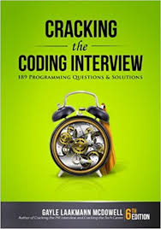

Slide 3
Why are we going through this?
Tech jobs have Technical Interviews
These are difficult
There is no “How to get a job” 101 course

Slide 4
Big-O
Aka the main reason CS majors take calculus.
So important it makes up the first technical chapter in the book
Usually introduced in CS 240
Used to describe the efficiency of algorithms
Absolutely mandatory knowledge to pass an interview
Best Case, Worst Case, Expected Case, Amortized

Slide 5
Time Complexity
Described as Big O or asymptotic run-time
Examples:
Adding two integers together -> O(1) or constant time
Printing elements of an array -> O(n) or linear time
Printing all integers up to n bits in size -> O(2^n) or exponential time

Slide 6
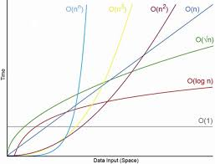
Important things to Note
Drop constant terms: O(2n) same as O(n)
Show most dominant Term: O(n^2 + 3n + 20) same as O(n^2)

Slide 7
Tricky example: All Sub-Arrays of an Array
Given an array of size n:
Breaking it down:
All sub arrays of size 1 + size 2 + size 3 + size 4 + … + size n
O(1n + 2(n-1) + 3(n-2) + 4(n-3) + … + n(n - (n-1))) <- Holy cow this is confusing
O(n+(n-1)+(n-2)+(n-3) + … + 1) <-drop constants
O(n(n+1)/2) <-sum from 1 to n -> O((n^2 + n)/2)
O(n^2) <- here it is!

Slide 8
Space Complexity
Like Time Complexity but space
Literally the amount of memory (space) required by an algorithm for input size n
Most commonly forgotten in interviews! (memory is cheap but it still matters)

Slide 9
Space Complexity: O(1)
int sum(int n){
Int summation = 0;
for(int i = 0; i < n; i++){
summation += i;
}
return(summation);
}

Slide 10
Space Complexity: O(n)
int sum(int n){
if(n <= 0){
return 0;
}
return n + summation(n-1);
}
Note: both programs take O(n) time but take different amounts of memory

Slide 11
Practice Q’s
void printUnorderedPairs(int[] arrayA, int[] arrayB) {
for (int i = e; i < arrayA.length; i++) {
for (int j = e; j < arrayB.length; j++) {
for (int k = e; k < 1eeeee; k++) {
System.out.println(arrayA[i] + ",. + arrayB[j]);
}
}
} }

Slide 12
Bad Fibonacci
int fib(int n) {
if (n <= 0) return 0;
else if (n == 1) return 1;
return fib(n - 1) + fib(n - 2);
}

Slide 13
Another Summation Problem
int sumDigits(int n) {
int sum = 0;
while (n > 0) {
sum += n % 10;
n /= 10;
}
return sum;
}

Slide 14
The Fun One
int intersection(int[] a, int[] b) {
mergesort(b);
int intersect = 0;
for (int x : a) {
if (binarySearch(b, x) >= 0) {
intersect++ ;
}
}
return intersect; }

